Slide 1
Weekly Writing
Prompt #1: Writing a bare bones MEAL paragraph

Slide 2
What’s going on in this picture? Tell the story…

Slide 3
Switching Modes: What is the mood of this painting? Respond in a MEAL paragraph.
What is the mood of Munch’s “The Scream” (M)
What in the painting is evidence of the mood? (E)
How does the evidence connect to the mood? (A)
Last Sentence/Conclusion (L)

Slide 4
Literary Analysis
Creative Writing allows you to create and tell the screaming figure’s story. There are no rules. Maybe he just escaped the mental hospital, maybe he’s being abducted by aliens, maybe he’s part of the illuminati…
Literary Analysis requires you use the evidence in the painting to reach a conclusion. We cannot make illogical leaps. We must stick to what is in the painting to answer the question. How do the brushstrokes, colors, objects, figures, etc. work together to create a certain mood? What is the mood?

Slide 5
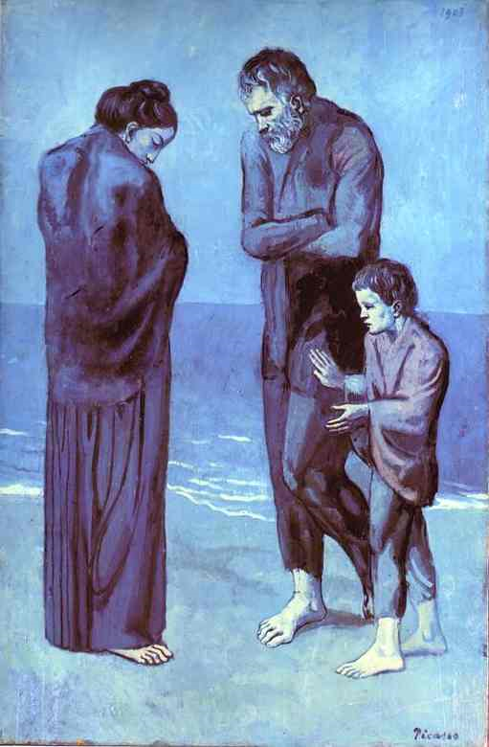
Picasso's “The Tragedy”
Write down any details that stand out to you.
Remember to stick to the evidence provided in the painting, NO ILLOGICAL LEAPS!!

Slide 6
Weekly Writing Assignment #1
What is the mood of Picasso’s “The Tragedy” (M)
What in the painting is evidence of the mood? (E)
How does the evidence connect to the mood? (A)
Last Sentence/Conclusion (L)

Slide 7
Take A Look At The Following Paragraphs:
By analyzing the details in Pablo Picasso’s “The Tragedy,” the illustrator intended to create a sad mood. People might think this because when they see the picture the first thing they see is a poor family huddled together, by seeing this it could make them feel upset.

Slide 8
The entire painting is blue which gives you the feeling of depression and unhappiness. The family looks poor and cold. That gave me the feeling that they could be sad about their lives and upset about their future.

Slide 9
Another piece of evidence backing up the mood is the abstract or fantasy like look of the painting. It suggests surrealism and nightmarish qualities from the wavy lines blending with each other and the straight lines leading towards the man in the foreground.

Slide 10
This is how the painting is showing a sad and gloomy mood.
For these reasons Picasso’s painting is depressing.

